Slide 1
AFA AIMS ADVOCATES TO INSPIRE MILITARY SERVICE AIMS Orientation for AFA Leaders
The purpose of this briefing is to help AFA leaders at all levels understand and explain the AFA AIMS program to their members. It may be helpful to use it in conjunction with the AIMS for AFA Leaders Information Paper
25 July 2024
campbell927@gmail.com AIMS.Communications@afa.org vanceclarke1@gmail.com V6

Slide 2
AIMS Overview
The purpose of this briefing is to provide an introduction to AFA AIMS (AFA Advocates to Inspire Military Service)
We have a partnership with Air Force Recruiting Service (AFRS) and a Letter of Intent signed on 12 Jan 2024. This letter is available upon request.
AIMS provides tools and information to allow AFA chapters and individual members to assist the Air Force Recruiting Service (AFRS) in their mission of recruiting members for the Air & Space Forces
We are not recruiters; that is AFRS’s job. We can be influencers who help by informing and Inspiring young people (and their influencers) towards military service
At the Chapter and individual level there are no requirements. AIMS only asks for your best efforts based on time and resources available, and in many cases just helps you do more efficiently what you’d probably do anyway: “Tell Your Story”
Our AIMS web page and Toolbox is designed to help but is only at the beginning stage. Your feedback and ideas will help make this a better resource

Slide 3
Why AIMS?
In FY23 the Army, Navy and Air Force all missed their recruiting goals.
AFA wants to help the AFRS where we can
There are two main factors which drive the recruiting problem:
Eligibility: Only 23% of youth of service age qualify to serve (Disqualifiers: weight, legal, drugs, multiple…)
Propensity: Only 9% say they have any inclination to serve and most know nothing about the military. Many have never met anyone who has served
There is probably little AFA chapters can do about Eligibility; however, we believe we can help with the Propensity problem
At the most basic level we can be advocates for the Air & Space Forces. In the words of AFRS Commander BG Chris Amrhein, “Tell Your Story” to help young people understand what the military is like and why it’s important
It’s likely that you may have more contact with the “influencers” (parents, teachers, coaches, and neighbors) than with young men and women. In many cases these influencers will also lack knowledge of our military and what we do, so it’s important to talk to them

Slide 4
The Environment
20.3M
12.5M
3.3M
370K
Talent acquisition is becoming harder and more expensive and American youth are increasingly disconnected from and less trusting of the military
17-21 Year Olds
3.5% Unemployment rate in the U.S.
46% of influencers would recommend military
39% of young adults (ages 17-35) do not comprehend the most basic military fundamentals (i.e. ranks, officer/enlisted, standards & requirements)
11% of young adults (ages 17-35) can name All DoD Active Duty Services
13% of 16-24 year olds with a parent who served
9% youth propensity and 2% propensed & qualified
23% of youth are eligible to enlist w/o a waiver
Academically Qualified
Academically Qualified & Eligible
Academically Qualified,
Eligible & Propensed

Slide 5
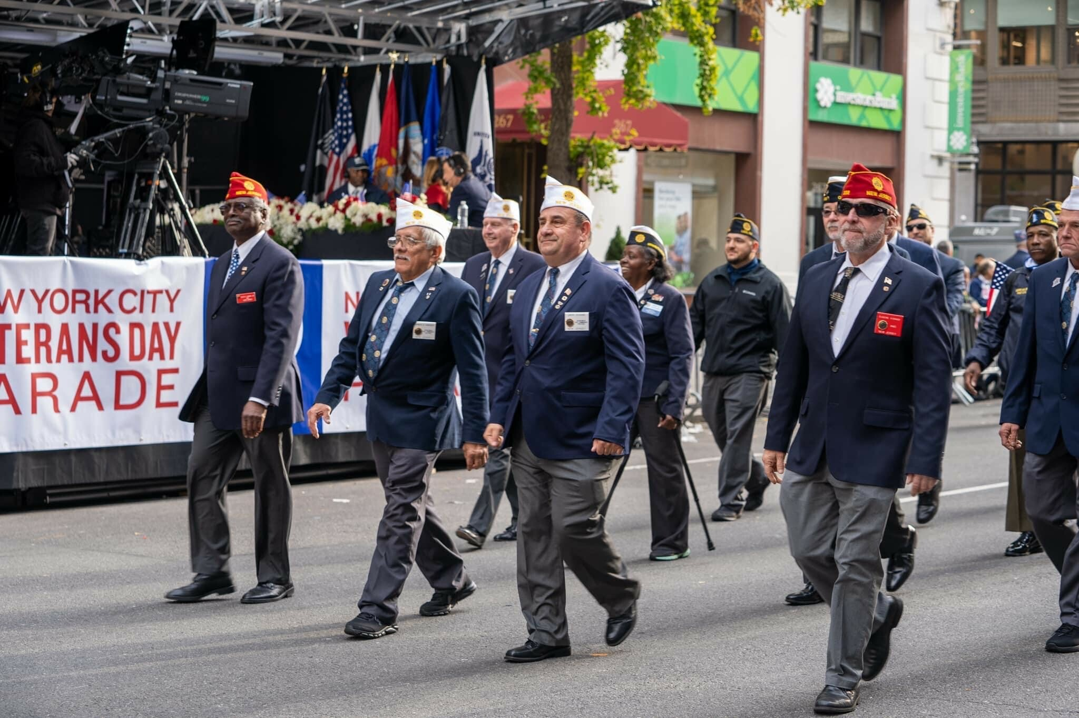
Foundational Challenge:
A Lack of Familiarity with the Military
Proportion of Youth with a Parent Who Served
Self-Reported Knowledge of the Military
YATS (1995) and Youth Poll (Fall 2022)
DoD Youth Poll (Fall 2022)*
Youth ages 16–24
Youth ages 16–21
Military
Active Duty
Reserve
Guard
40%
13%
1 2
Not At All Knowledgeable
3
4
5
6
7
8
9 10
Extremely
In 1995
In 2022
Knowledgeable
How likely do you think it is that someone
getting out of the Military will have…?
DoD Ad Tracking Recruits Study (Oct–Dec 2022)
Youth ages 16–24 % Responding “Likely/Very Likely”
Some form of psychological or
emotional problem
62%
Difficulty readjusting
to everyday life
55%
Some form of physical injury
51%
Most youth are unfamiliar with the Military and are focused on the perceived risks and potential negative outcomes of service.
8

Slide 6
Elements of AIMS
Be an advocate for the Air & Space Forces (A&SF) by looking for opportunities to tell your story and the A&SF story whenever you can, to as many different audiences as you can. Use the AIMS Toolbox to help with current information and ideas
Reach out to your recruiters, get to know them and offer to assist. Identify your chapter (and yourself) as a volunteer by registering via the AIMS Opt-In/Out Database (OIDB) so that you are highlighted on the Chapter-Squadron Contact Map
Reach out to A&SF-affiliated organizations: AFROTC, AFJROTC, CAP, Silver Wings, Arnold Air Society to help Inspire those who are already interested
Reach out to community organizations: Rotary, VFW, American Legion, etc. Contact with local schools may be especially helpful to facilitate recruiter access
Become familiar with the various programs and applications which facilitate communication and education: AIM HIGH App, AIMS Guide, etc.
We’ll be adding information in the Toolbox as we go!

Slide 7
The AIMS Web Page
The AIMS web page is designed to help you be a great advocate for our
Air & Space Forces
It includes:
An AIMS overview
A call to action from the AFRS Commander
A Chapter-Squadron Locator map to help AFA chapters and AFRS Squadrons contact each other
The AIMS Toolbox with resources, information and ideas
FAQs about AIMS
Consider this Version 1.0. Please explore and comment so we can make continuous improvements

Slide 8
Individual/Chapter-AFRS Interaction
The AFRS Commander requested Individual/Chapter contact information so recruiters can reach out to Chapters for assistance. We hope this can be a very productive part of AIMS
The Chapter-Squadron relationship is a work in progress, and we want to learn as we go and share ideas. The most important thing is to be responsive if you get a call for help and to get to know recruiters as time and resources permit
The Chapter-Squadron Locator Map on the AIMS web page provides an interactive way to make contact. The map (see next page) shows contact info for all AFRS squadrons and AFA chapters and individuals who have volunteered through the Opt-In/Out Database. The volunteer process eliminates inactive chapters and improves the chances for a successful engagement
Different squadrons and chapters will have different needs and capabilities.
See the AIMS Guide 1.1 in the Toolbox for ideas.
Please provide feedback to Vance Clarke (AIMS.Communtications@afa.org)

Slide 9
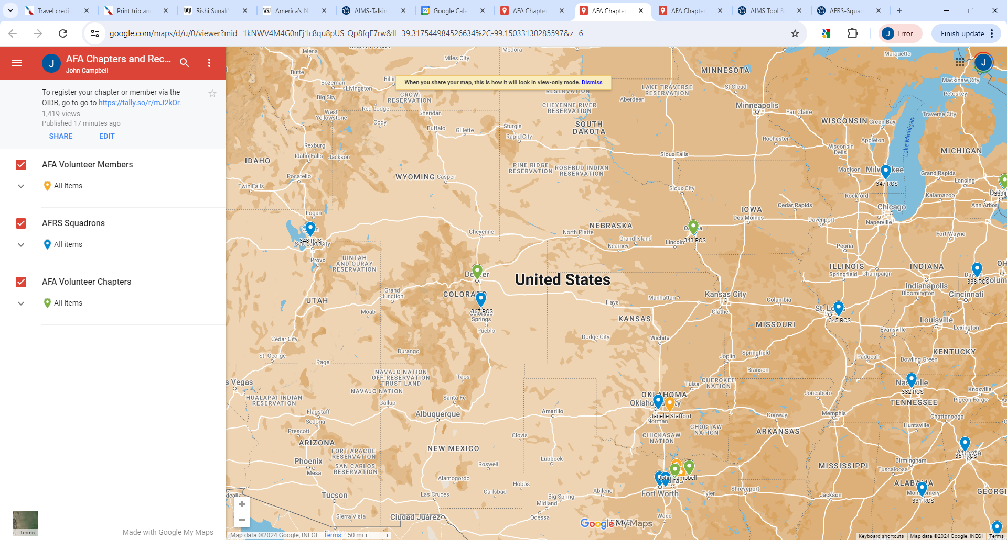
Chapter-Squadron Locator Map
Contact info will appear here when you click on a pin. You can deselect layers as desired
AFA Volunteer Individual
AFRS Squadron
AFA Volunteer Chapter

Slide 10
AIMS Opt-In/Out Database (OIDB)
Why: To increase probability of successful Chapter-Recruiter interactions
What it Does:
Enables us to identify/display on our map active chapters (and individuals) who want to engage with recruiters
Allows chapters to specify what information is displayed; and an Opt-Out option
How It Works:
Click the SUBMIT YOUR INFORMATION link in the blue box on the AIMS web page
Fill out the requested information. Can be for a Chapter or an individual
The information goes to the AIMS POC who will update the map

Slide 11
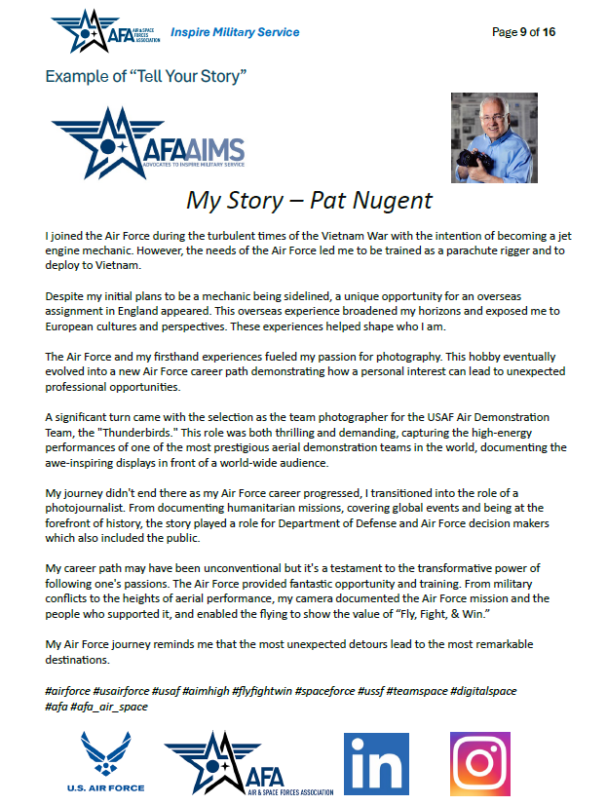
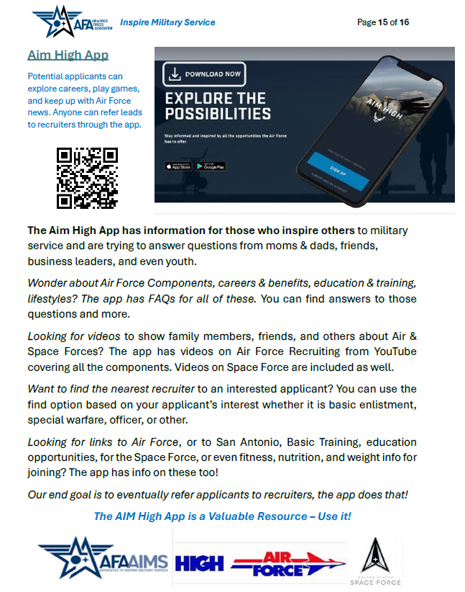
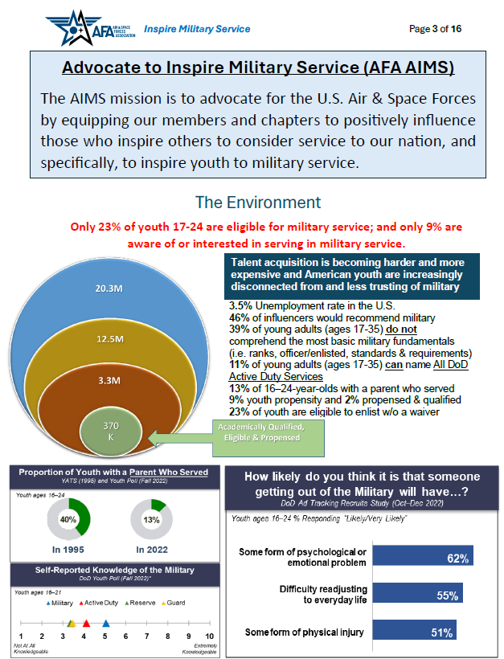
AIMS Guide 1.1

Slide 12
Closing Thoughts
The recruiting problem is likely to get worse and we hope AFA can be part of the solution
AIMS is a work in progress. We’re at IOC and we’ll improve as we go
We know chapters are busy and resources can be limited. There is no pass-fail grade for AIMS. We encourage individuals/chapters to apply effort as time and resources permit
AFRS has professional recruiters with an increasingly tough job. They are busy people who are focused on results and it’s not yet clear how we can be most helpful to them. The key will be to reach out and make contact, be responsive if asked and share lessons learned so other chapters and squadrons can benefit
The Toolbox is the heart of AIMS. Poke around and explore and provide feedback
Long-term we hope to record best practices and lessons leaned so we can share good ideas across the Association

Slide 13
Questions/Comments?
AIMS.Communications@afa.org
campbell927@gmail.com vanceclarke1@gmail.com

